Slide 1
Virtual App Development Challenge and Workshop
NSU & SNL Hack-a-thon Fall 2021
November 20-21, 2021

Slide 2
What's the plan?
About Us!
About Sandia!
Full Stack Overview
How to Flutter
Experimental Period!

Slide 3
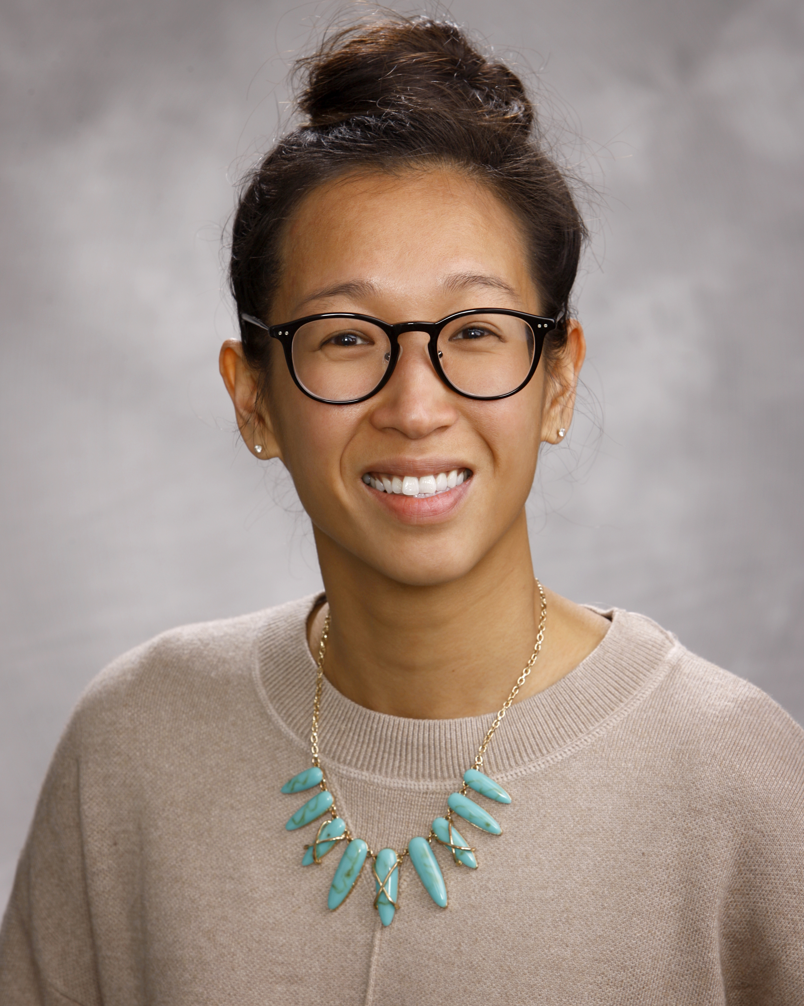
Ellen (Le) Wagman, R&D Computer Science, Solid Mechanics Code
Background
Ph.D. CSEM, Oden Institute, UT Austin, 2018.
Advisors: Tan Bui-Thanh and Quoc P. Nguyen
Thesis: “Data-Driven Strategies for Bayesian Inverse Problems”
August 2018: Postdoc at Sandia CA (Livermore)
Materials UQ project for Thermal/Fluids Science & Engineering (8751)
Paper in Fire Safety Journal, July 2021. doi: 10.1016/j.firesaf.2021.103333
Paper in ASME VVUQ, Dec 2021. doi: 10.1115/1.4051638
September 2019: Full-time code development at Sandia NM (Albuquerque)
SIERRA/Solid Mechanics (1542), see next slide
Current Work at Sandia
Develop solid mechanics code capabilities for applications in the national interest (mostly in C++). Solve problems and make things better!
Write, test, review, document, and debug. Plan, mentor, and communicate (a lot!) with my team, the product owner, and other stakeholders.
Advise other code teams (Thermal/Fluids, meshing, DevOps), internal/external customers, managers.

Slide 4
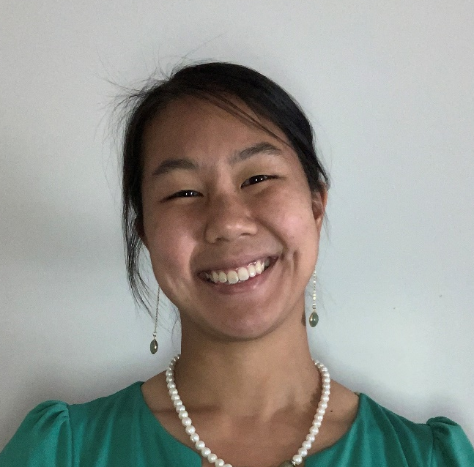
Olivia Hon, R&D Computer Science, Systems Mission Engineering
Background
M.S. CS, College of Computing, Georgia Institute of Technology, 2020.
Interned at Sandia Summer 2019 in Systems Mission Engineering and Emergent Systems & Analysis.
Converted to a year-round intern, working remotely until May 2020.
Joined Systems Mission Engineering as full time staff in May 2020 for the Product Management & Exploitation team.
Work at Sandia
Develop software to process and disseminate large amounts of sensor data to multiple parties as close to real time as possible.
Work a lot with other teams to make sure that they get the data that they need.
Assist with research in machine learning and deep learning on the side.

Slide 5
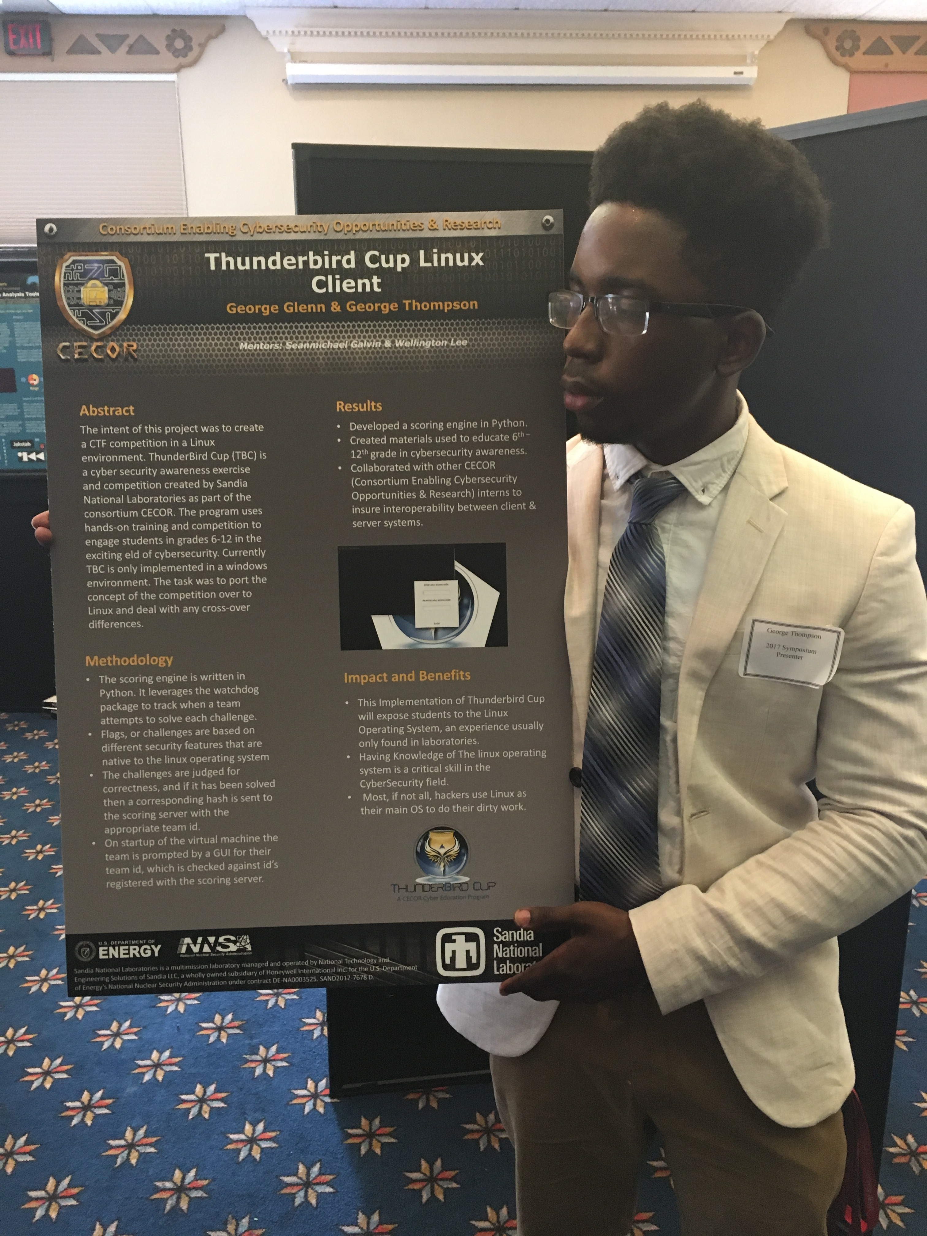
George Thompson, R&D Computer Science, Advanced Information Security
Background
B.S CS, College of Science of Engineering and Technology, Norfolk State University, 2018.
M.S. CS, College of Engineering, North Carolina A&T State University, 2020.
Interned at Sandia Summer 2017 as part of the CECOR program.
Interned a second time Summer 2018 as part of TITANS Software
Converted to a year-round intern, working remotely until May 2020.
Joined Advanced Information Security as full time staff in May 2020
Work at Sandia
Develop Software that makes Information Assurance easier for developers/Stakeholders
Help Pen test applications at Sandia to ensure no vulnerabilities in Sandia software
Develop Capabilities to help advise teams Around Sandia about Software Security
Develop tools that assist in Vulnerability Research

Slide 6
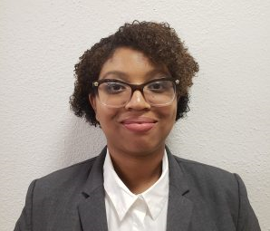
Jasmine Mabrey, R&D Computer Science, Surety Software
Background
B.S CS DNIMAS, College of Science of Engineering and Technology, Norfolk State University, 2018.
M.S. CS, College of Engineering, North Carolina A&T State University, 2020.
Interned at Sandia Summer 2017 as part of the CECOR program.
Masters Fellowship Participant 2018 –2020
Joined Surety Software Development as full time staff in May 2020
Work at Sandia
Develop software tools to generate various test material for Surety Developers
Help in the validation of cryptographic algorithms before implementation in Sandia products
Assist with interface testing capabilities for different systems

Slide 7
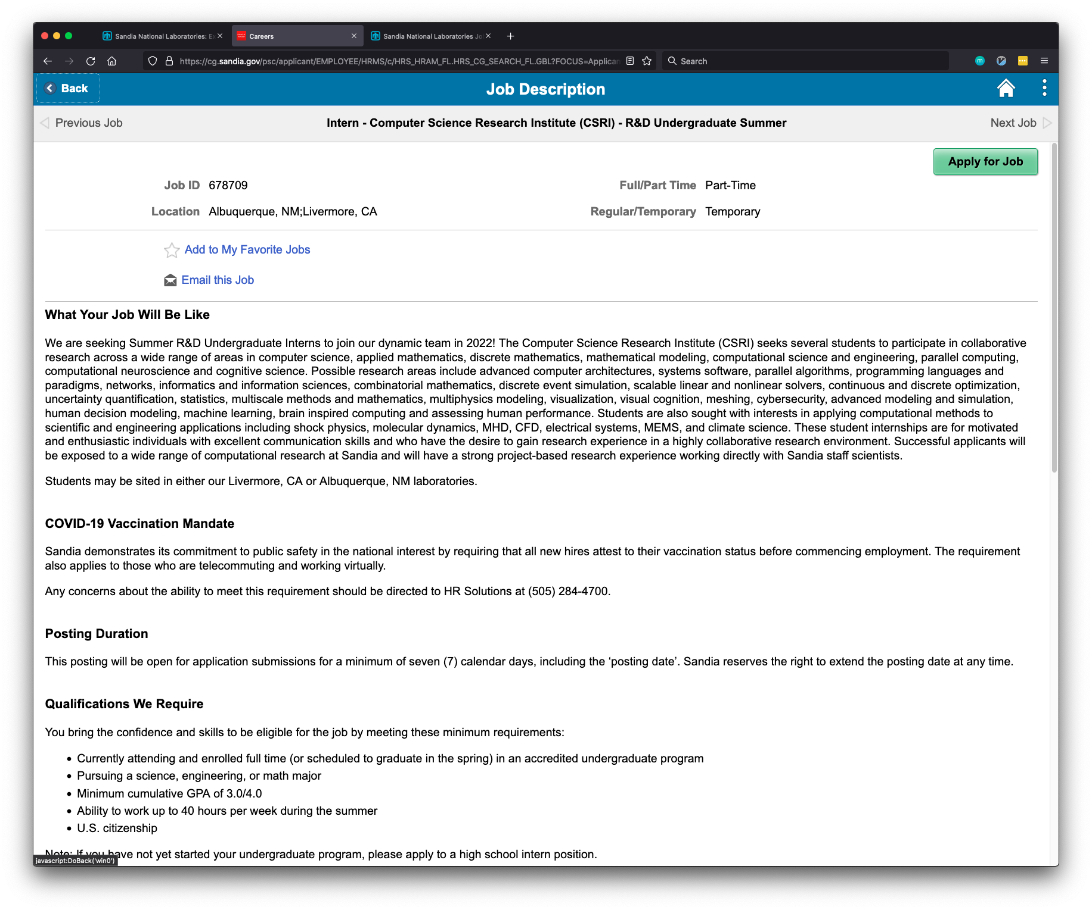
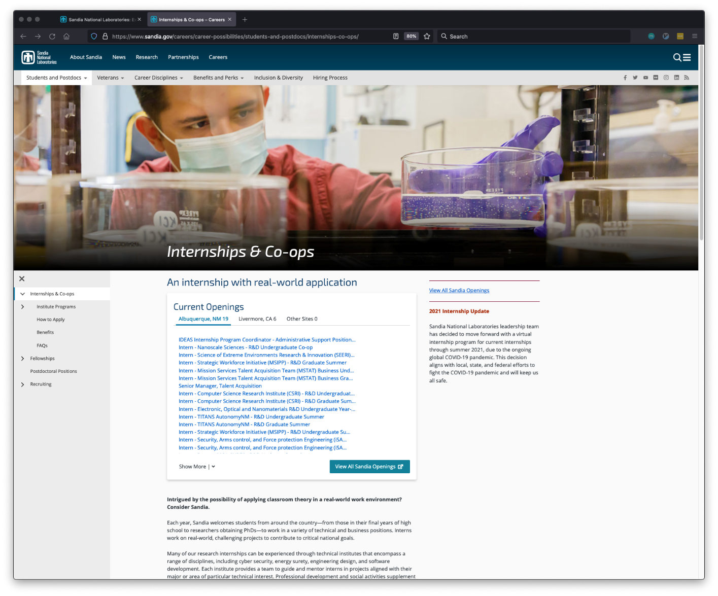
Demo – How to find, select, and apply for Sandia internships or jobs!
Apply now!
Bookmark this link:
https://www.sandia.gov/careers/career-possibilities/students-and-postdocs/internships-co-ops/

Slide 8
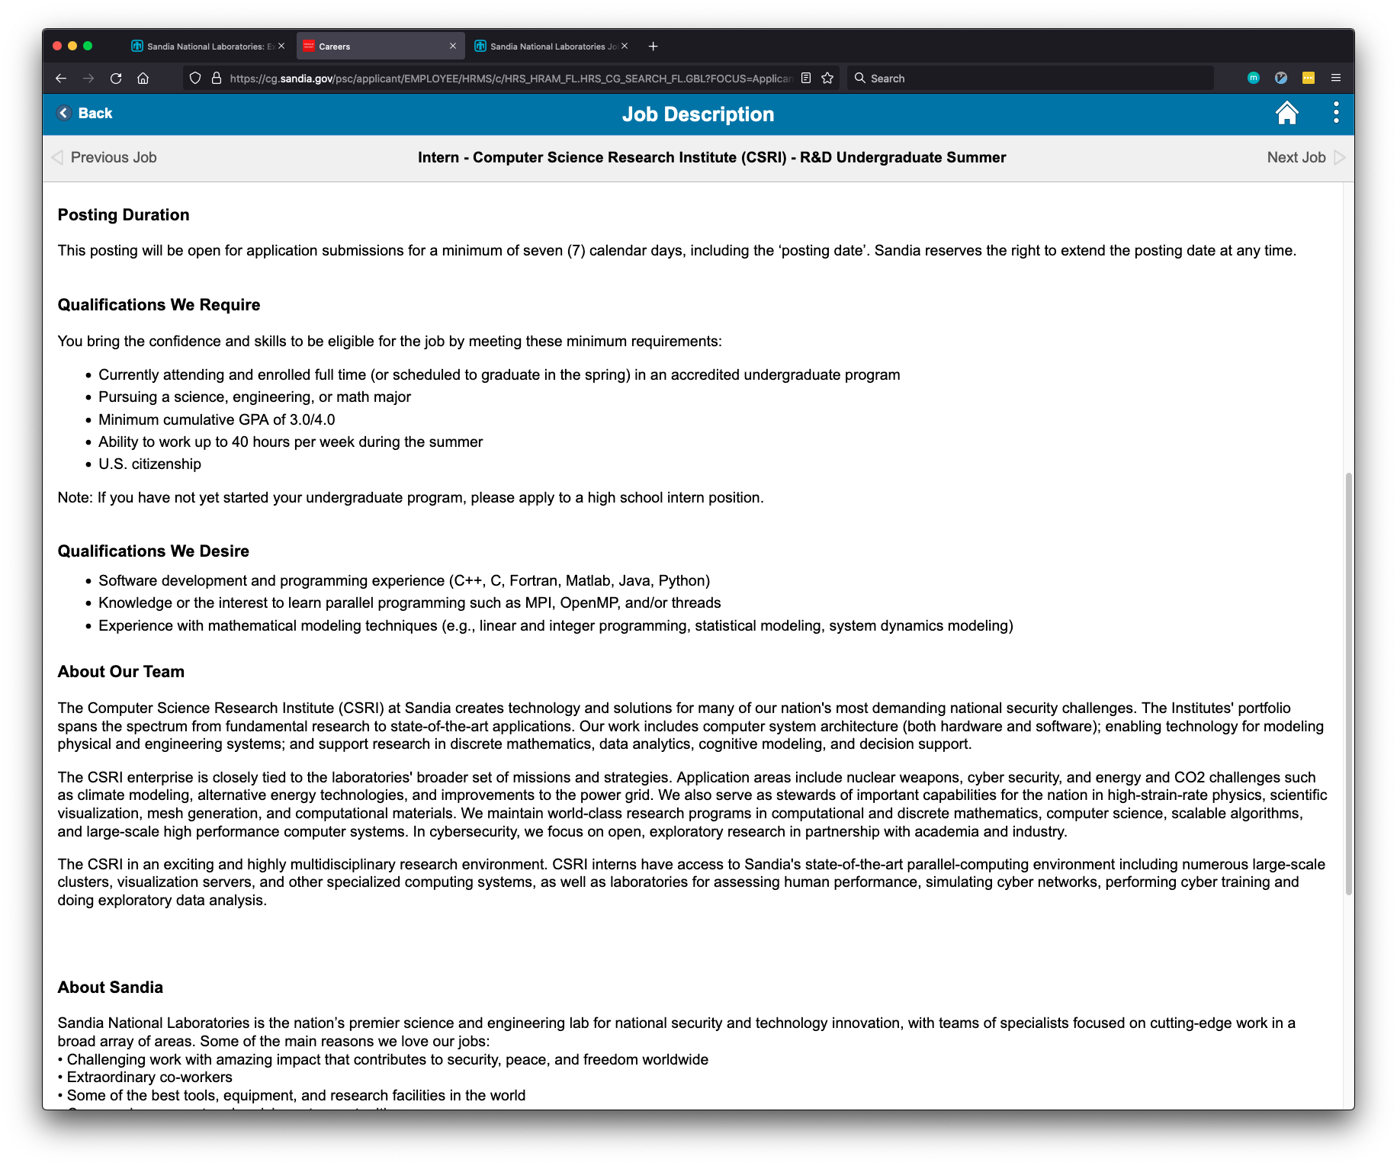
Sandia Internships posted weekly – bookmark jobs.sandia.gov!
Bookmark this link now!
https://www.sandia.gov/careers/career-possibilities/students-and-postdocs/internships-co-ops/
Internships are posted weekly and have varying closing dates (depends on the department).
Pay attention to “Qualifications We Require”. Applications not meeting the requirements are often filtered before reaching the hiring manager!

Slide 9
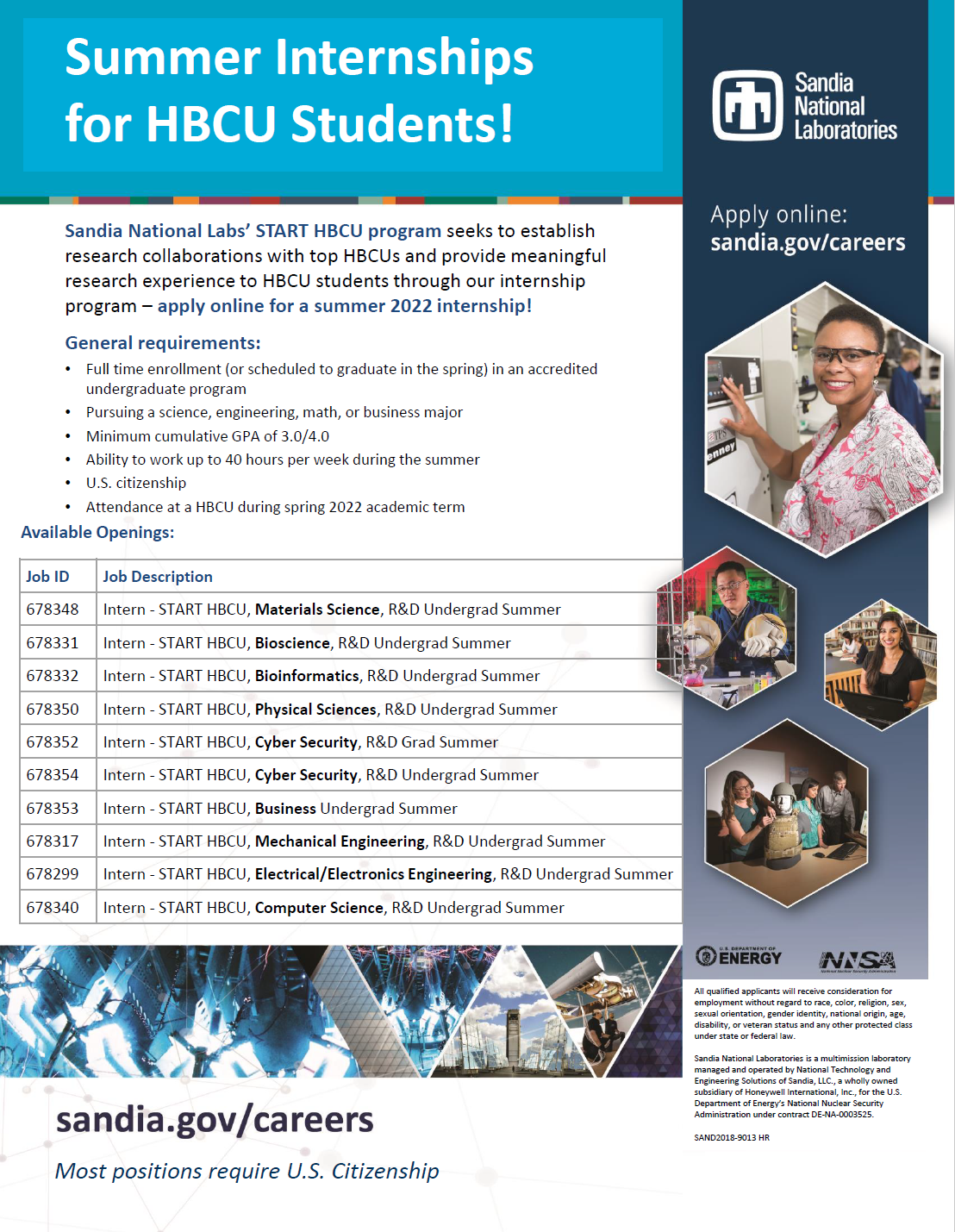

Slide 10
Full Stack Overview
Refers to all phases of developing an application
A “full stack developer” refers to someone who has experience in all categories
More common now for a team to be dedicated to each phase
Depends on the size of your application
Back End
Database
DevOps
Mobile App
The Full Stack
Front End

Slide 11
Front End: The Storefront
The part that looks good
Responsible for user interaction
Technologies Used:
HTML/CSS
Javascript
Frameworks
React
Angular
STUFF 4 SALE!
MORE STUFF!
Buy some stuff
!
!
!
!

Slide 12
Back End: The Employee
Communicates between the Front End and the Database
Technologies Used:
Node
PHP
Ruby on Rails
Python
EMPLOYEES ONLY
Sure, I can check the back for you.
$

Slide 13
Database: The Warehouse
Where all of the data is stored
Technologies Used:
SQL
MySQL
Postgres
MongoDB
Elastisearch
Pickle id:7
Ticket id: 89
Ticket id: 88
Tomato id: 57
Tomato id: 112
Stuff
Can of Worms
Id: 8

Slide 14


Dev Ops: The Landlord
Front End
Back End
Responsible for environments where everything runs
Oversees deployment into production
Technologies Used:
Azure
Docker
Jenkins
505 NOT FOUND
505 NOT FOUND
Let’s bring the backup warehouse online first.
Database
Mobile App
HELP WE’RE ON FIRE
Out to

Slide 15
Mobile App
No analogy needed since they named themselves really well
Specifically centered around user interaction with the mobile app
Technologies Used:
Java for Android
Swift for iOS
React
PRESS THE BUTTON
WE SWEAR IT WORKS.

Slide 16
Back End Deep Dive
Front End
Database
How many apples do you have?
Did you mean ‘APPLE’?
Translate requests between the Front End and the Database via API calls
???
How many apples do they have?
SELECT COUNT(*) FROM FRUIT WHERE TYPE = ‘APPLE’
23
OK! 23.

Slide 17
API Calls
POST
GET
PUT
DELETE
Create an object or record in the database
Get data about a specific object or record in the database
Update an existing object or record in the database
Delete an existing object or record in the database
Need to pass in data related to the object to be created
Need to pass in something that identifies the object you want (like an id)
Need to pass in something that identifies the object you want to update, and then the updated values
Need to pass in something that identifies the object you want to delete
Returns a ‘OK’ or ‘ERROR’ back
Returns the object that you want
Returns the object with the updated fields as they are saved in the database
Returns an ‘OK’ or ‘ERROR’, depending on how it goes

Slide 18
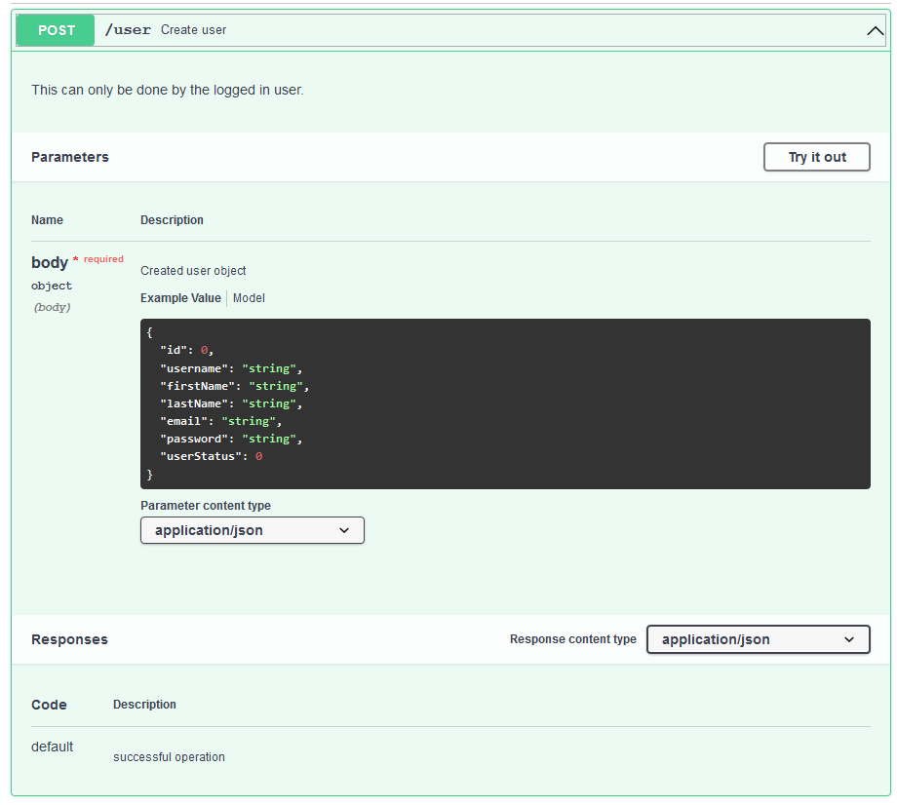
Reading API Documentation
1
Every API comes with a base URL.
http://api.example.com
Note the type and the endpoint. If the request goes to the wrong endpoint, all you’ll get is error messages back.
Each request will come with required parameters. Here, you need to pass in a JSON object. If you don’t give the right parameters, it’s errors all the way.
The expected return message. Note the format (here it is a JSON message), which will tell you how to parse it to get a success or error.
2
3

Slide 19
Questions?

